Slide 1
Data representation
Lecture 2
IFT6758, Fall 2020; Reading: IDS - Chapters 8, 9, 10

Slide 2
Extracting information from data
A picture is worth a thousand words: can we see the data in pictorial format?
Effect of informative data representation: e.g., News organizations increasingly embracing data journalism and including effective infographics as part of their reporting.
Data visualization is the strongest tool of what we call exploratory data analysis (EDA). John W. Tukey, considered the father of EDA, once said,
“The greatest value of a picture is when it forces us to notice what we never expected to see.”

Slide 3
PART-1: Visualizing data distributions

Slide 4
Types of variables
Types of variables: Categorical (ordinal or not) and numerical (discrete or continuous)
Example:
Categorical: Sex (Male, Female), Regions (North, South, East, West). Ordinal: when there is a sense of order, Spiciness (Mild, Medium, Hot)..
Numerical: Height (continuous), Price (continuous), Population sizes (discrete)..
Discrete numeric data can be considered ordinal.
Conventionally, ordinal for variables belonging to a small number of different groups, with each group having many members: e.g.: the number of packs of cigarettes a person smokes a day, rounded to the closest pack
Discrete numerical for many groups with few cases in each group: the actual number of cigarettes in each pack

Slide 5
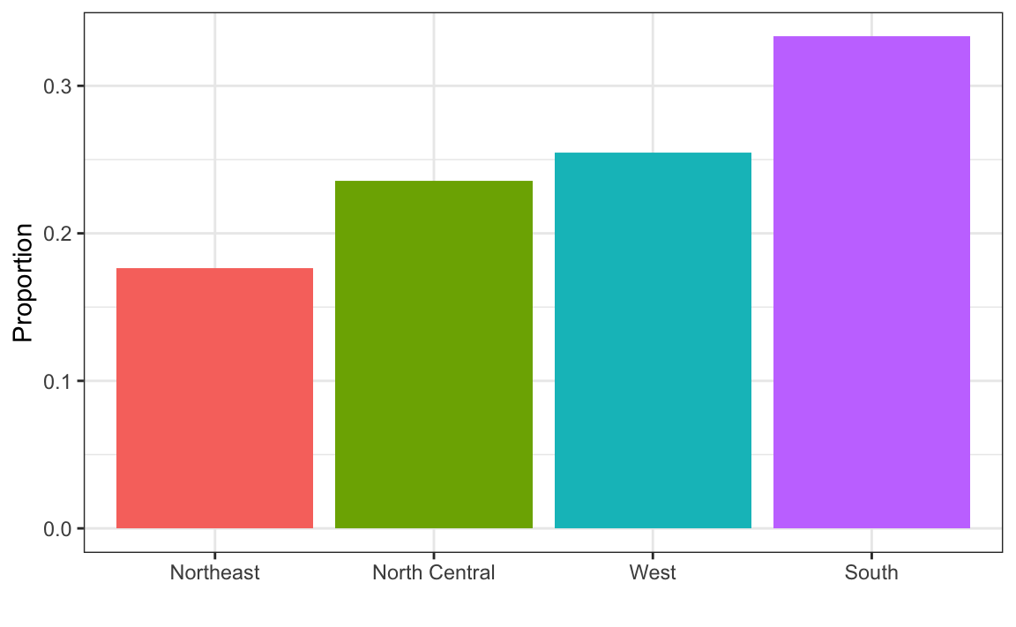
Distribution function
With categorical data, the distribution describes the proportion of each unique category
Two-category frequency table is sufficient for comprehension:
Example: Female 0.227, Male 0.773
Visualize for more than two categories: example – bar plot for US population

Slide 6
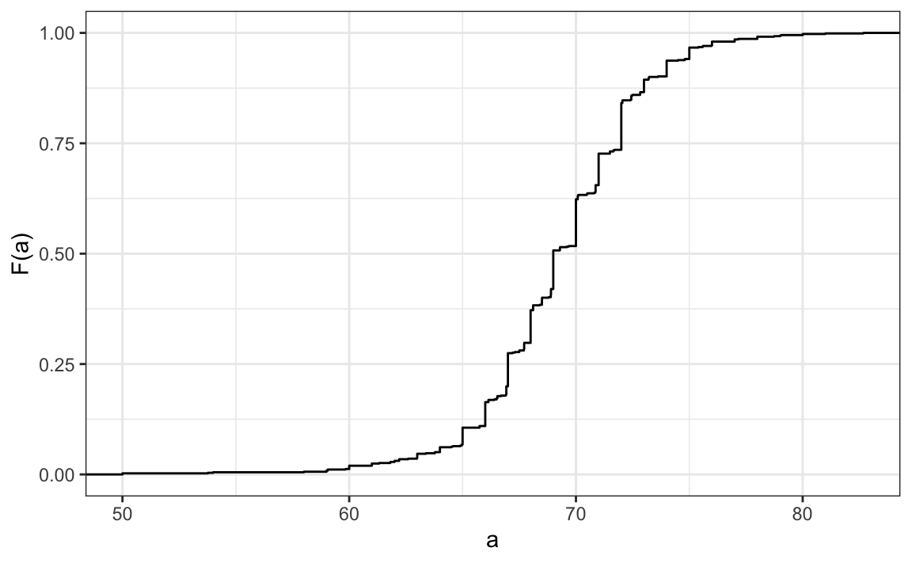
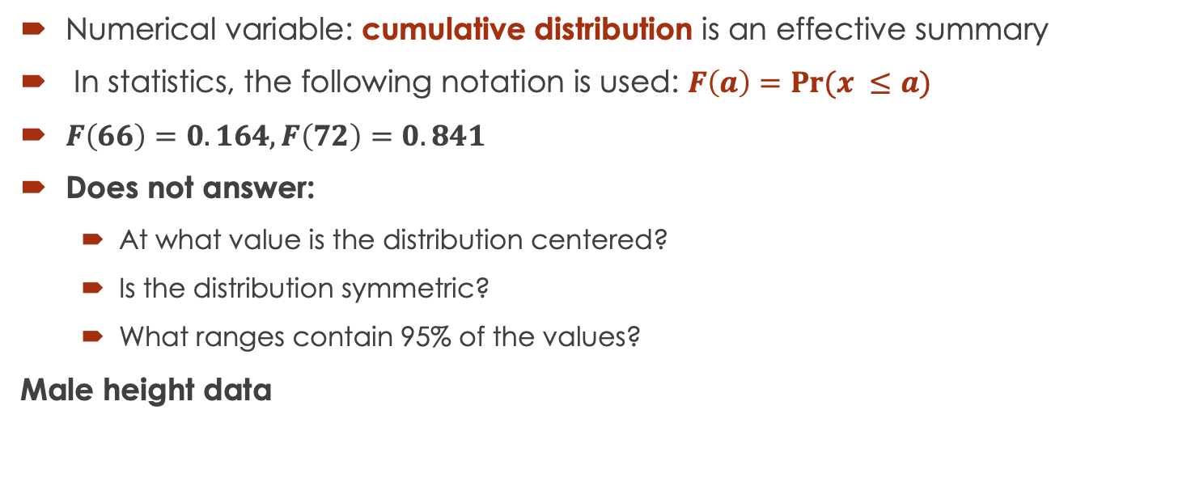
Cumulative distribution functions
Numerical variable: cumulative distribution is an effective summary
In statistics, the following notation is used: $F\left(a\right)=Pr⁡(x ≤a)$
$F\left(66\right)=0.164, F\left(72\right)=0.841$
Does not answer:
At what value is the distribution centered?
Is the distribution symmetric?
What ranges contain 95% of the values?
Male height data

Slide 7
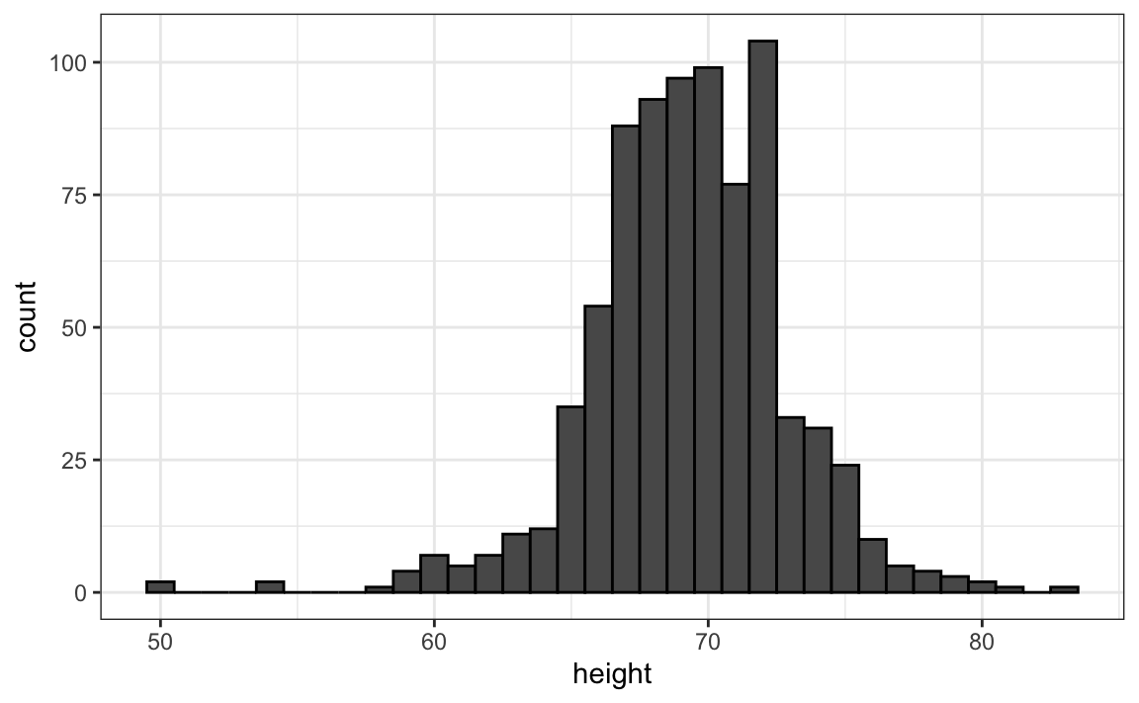
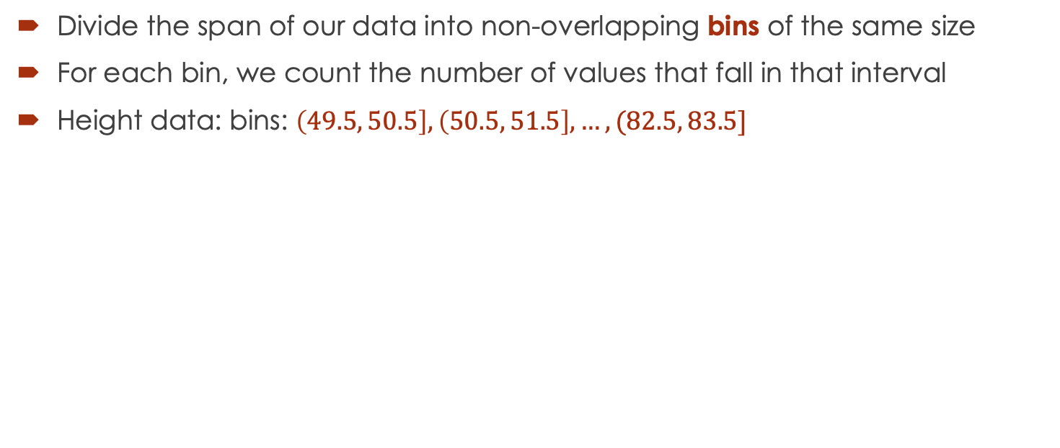
Histograms
Divide the span of our data into non-overlapping bins of the same size
For each bin, we count the number of values that fall in that interval
Height data: bins: $\left(49.5, 50.5\right], \left(50.5, 51.5\right], …, (82.5, 83.5]$

Slide 8
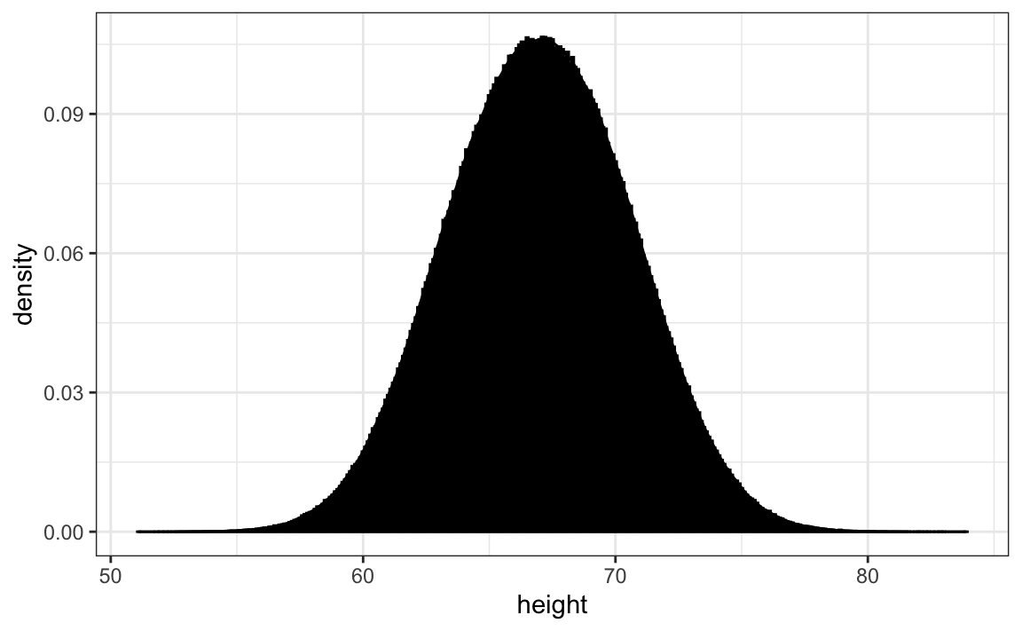
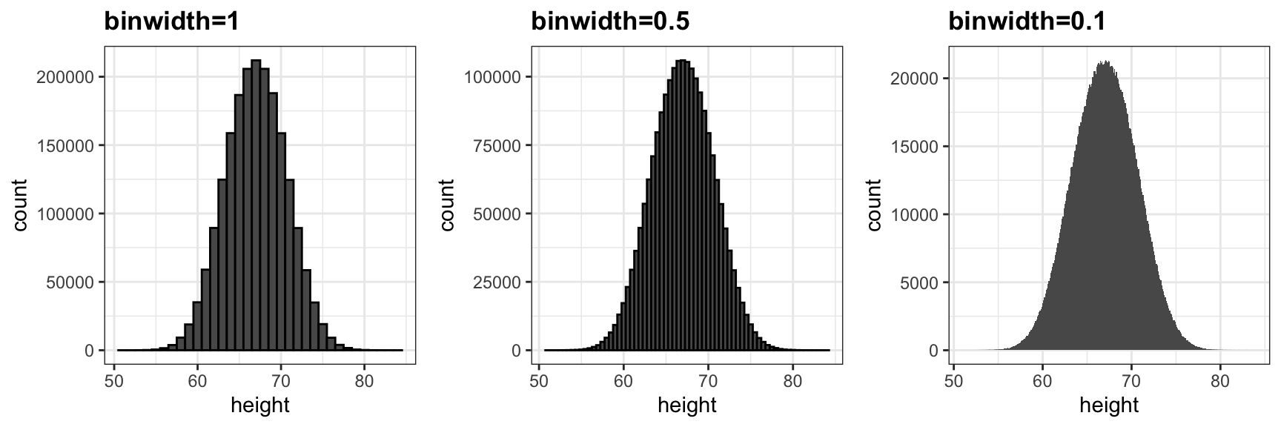
From histogram to smooth density

Slide 9
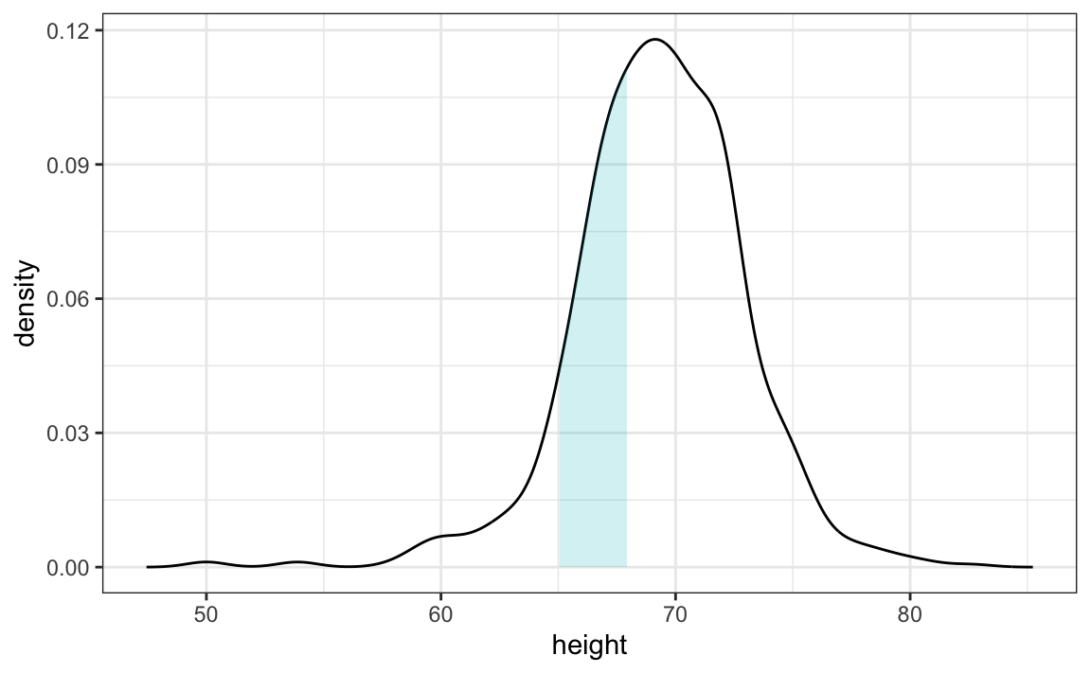
What is density?
Proportion of values between 65 and 68
The proportion of this area is about 0.3, meaning that about 30% of male heights are between 65 and 68 inches.

Slide 10
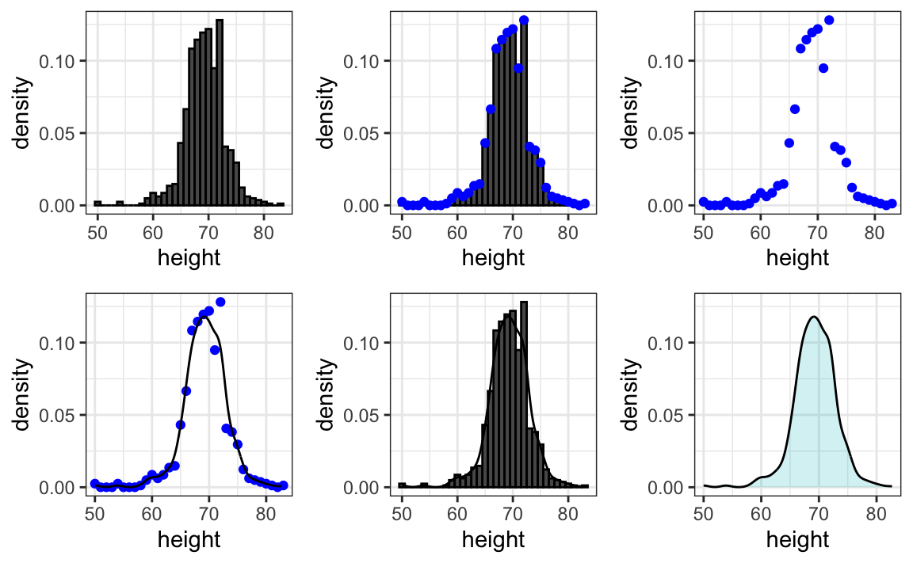
The transition to smoother density

Slide 11
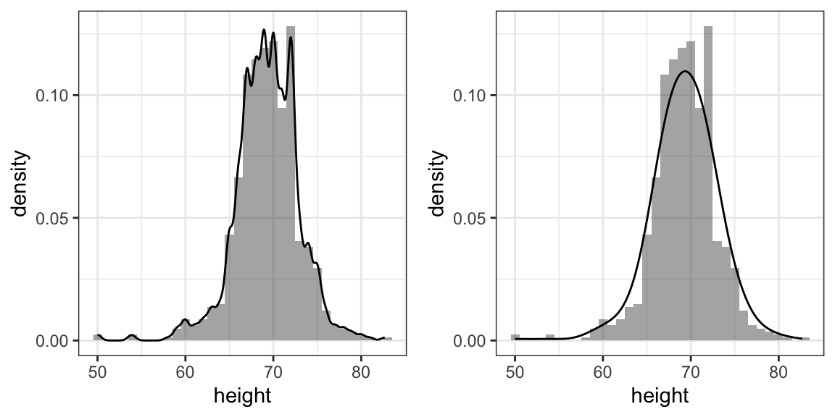
Smoothness is relative
Kernel Density Estimator
Scipy, Scikit-Learn
Smoothness varies with Bandwidth

Slide 12
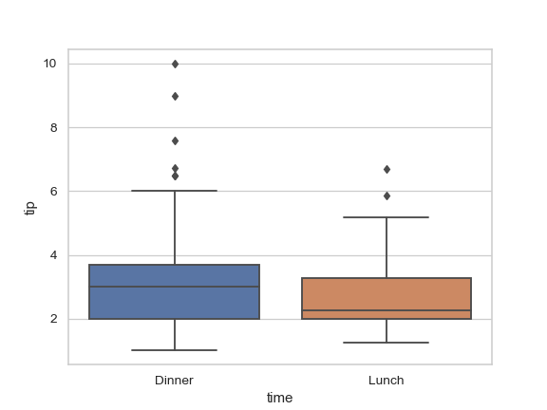
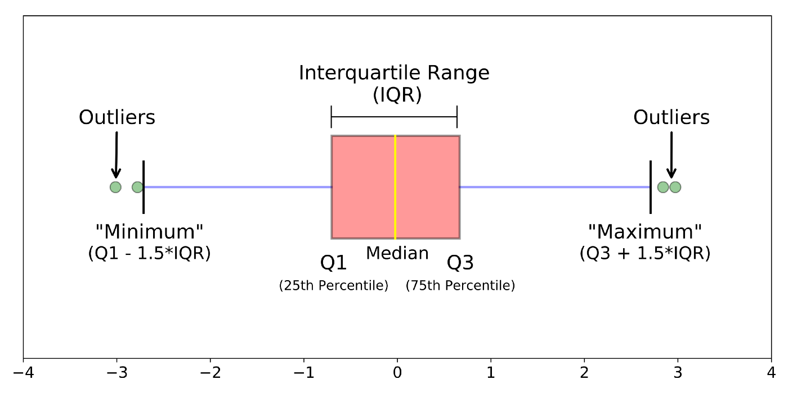
Boxplots
Matplotlib, Seaborn
Helps detecting outliers

Slide 13
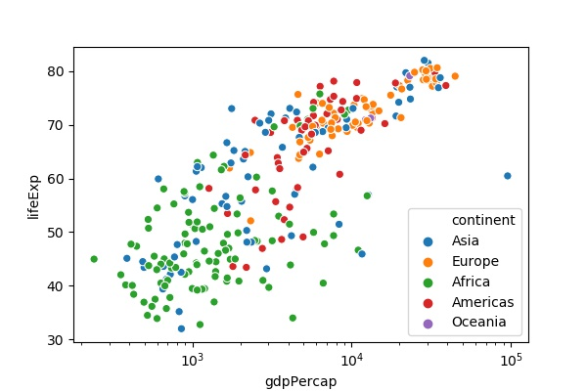
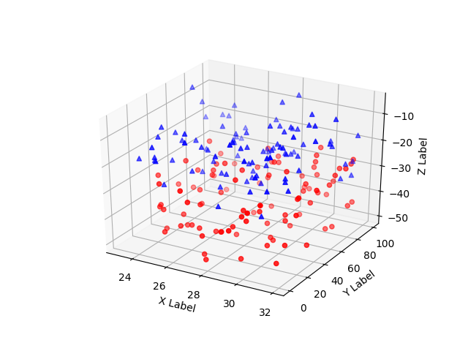
Many more to go…
E.g. Scatterplot
Matplotlib, Seaborn

Slide 14
PART-2: Data visualization in practice

Slide 15
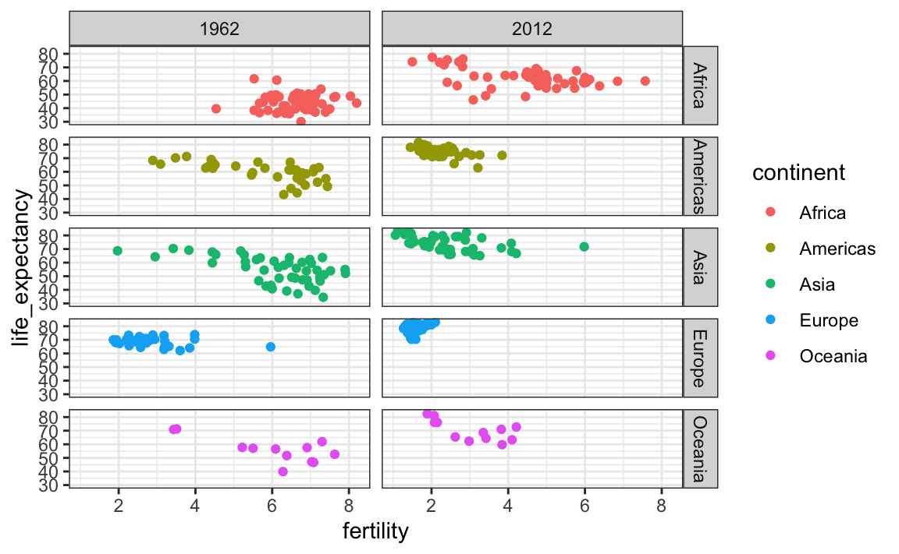
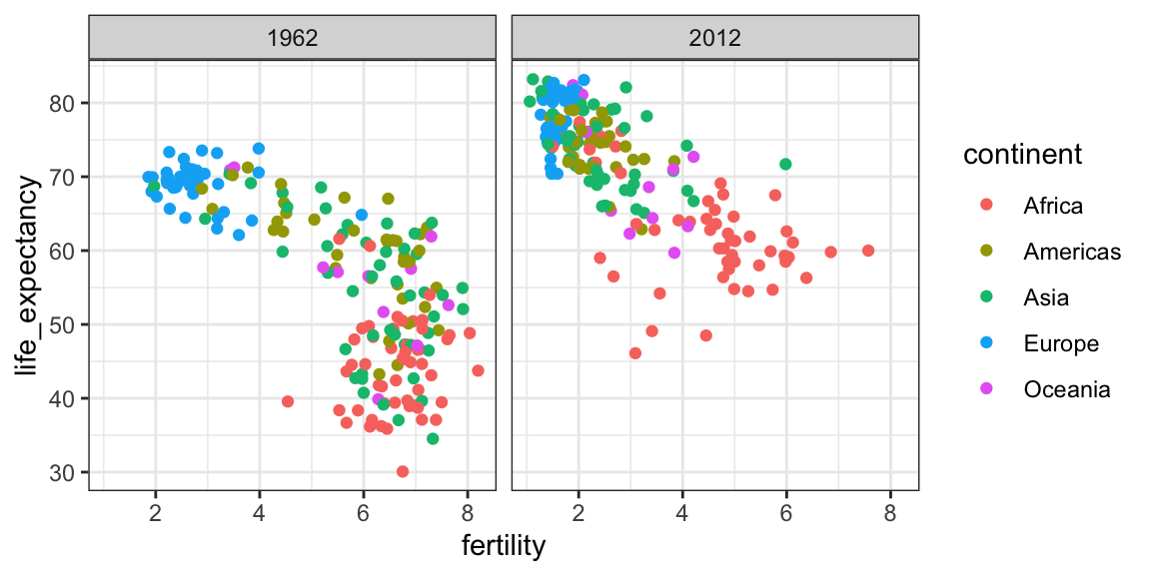
An example: Gapminder data
Independent Swedish foundation with huge global datasets based on reliable statistics; develops data visualization tools; Gapminder homepage
Gapminder data with Kaggle
Example: plots with Gapminder data
Use subplots for better comparison.

Slide 16
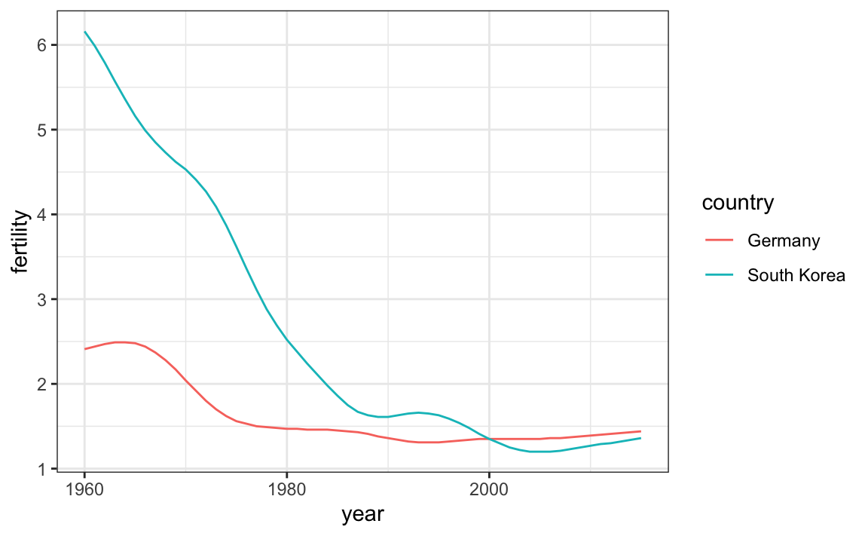
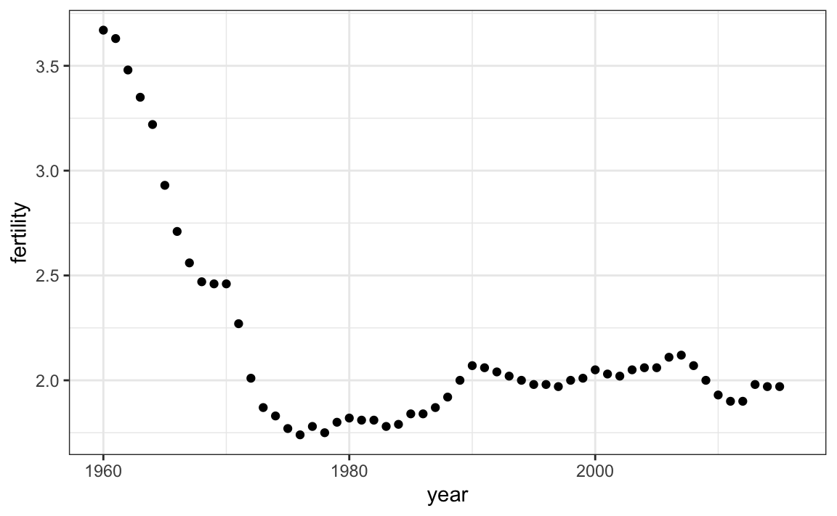
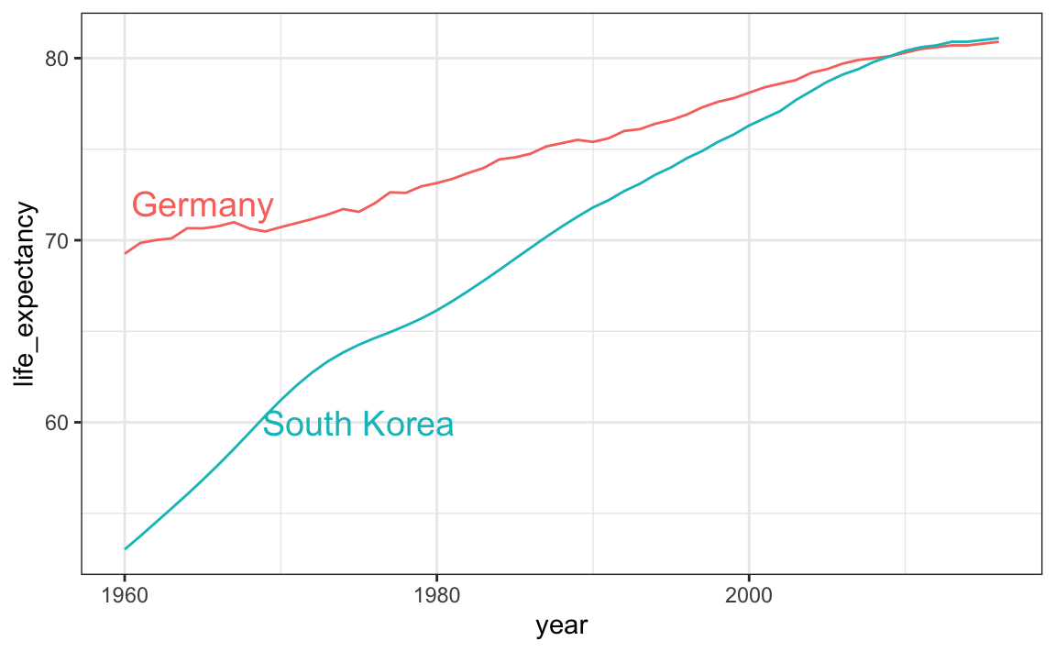
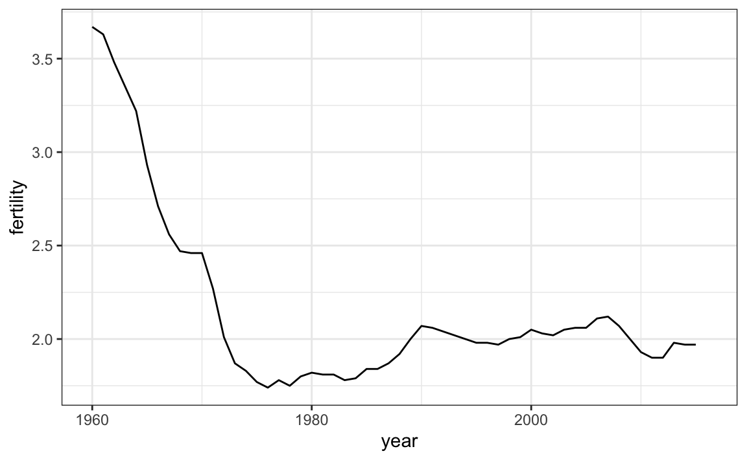
Time series plots
Use different line styles
Use colors and legends

Slide 17
PART-3: Data transformation

Slide 18
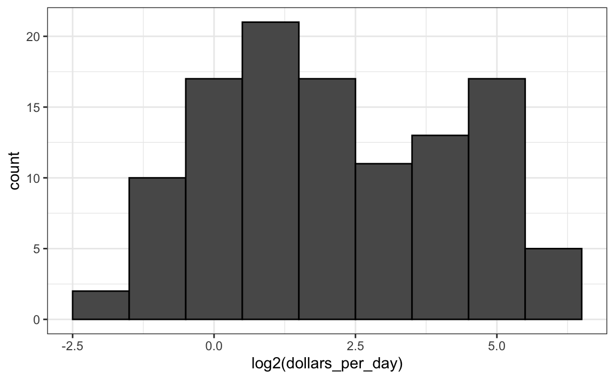
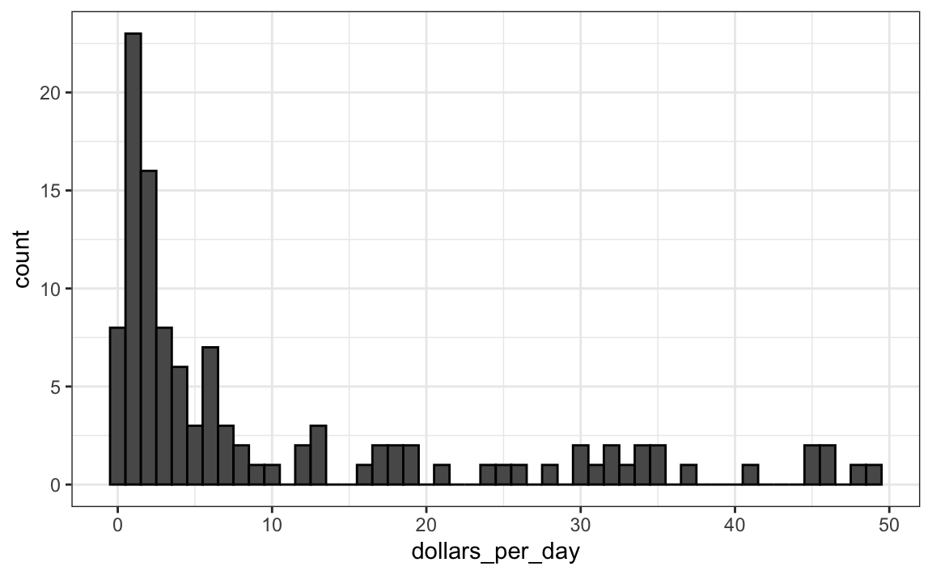
1. Log-transform
Example: Histogram of US per-day income in 1970

Slide 19
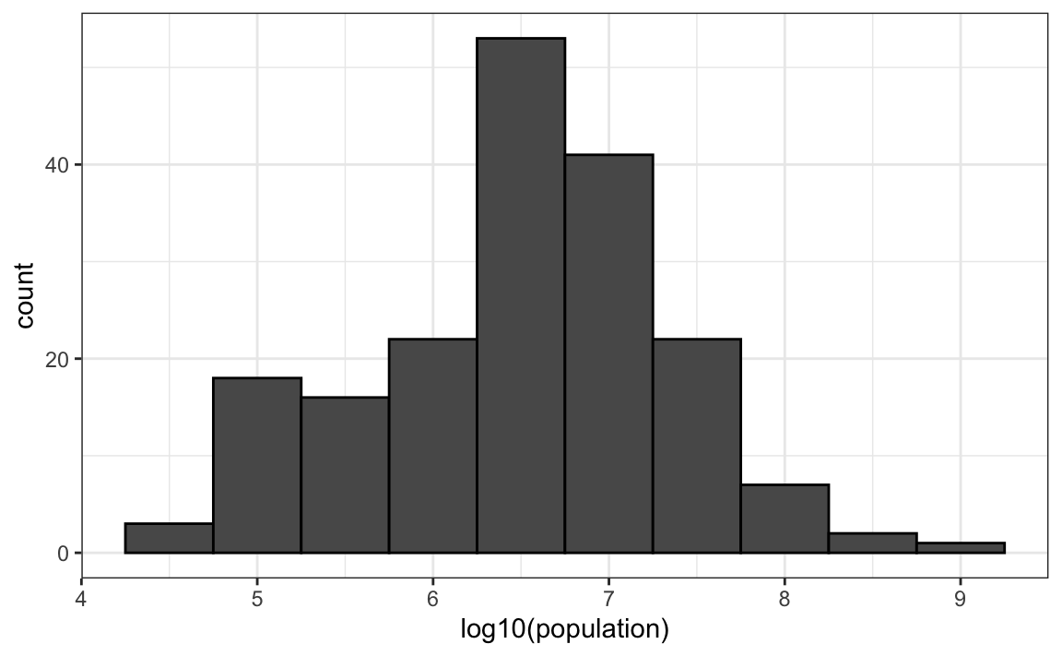
Log-transform
A different base might be better: Population

Slide 20
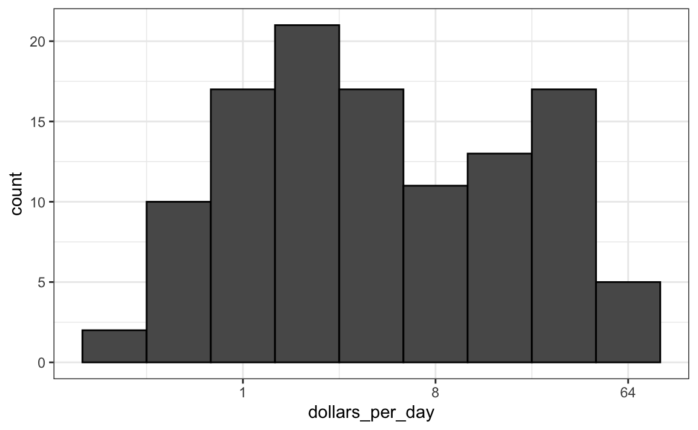
Transform value or scale?
Transforming scale sometimes provides better interpretation

Slide 21
2. Tidying data
Tidying: Structuring datasets to facilitate analysis
Rules of thumb
Functional relationships are easiest to see through columns
Group comparisons are easiest to see through rows
An observation is the smallest unit you’d like to draw conclusions or make predictions about
Codd’s 3rd normal form:
Each variable forms a column.
Each observation forms a row.
Each type of observational unit forms a table.
A simple example
Case study: billboard data

Slide 22
PART-4: Principles of Data Visualization

Slide 23
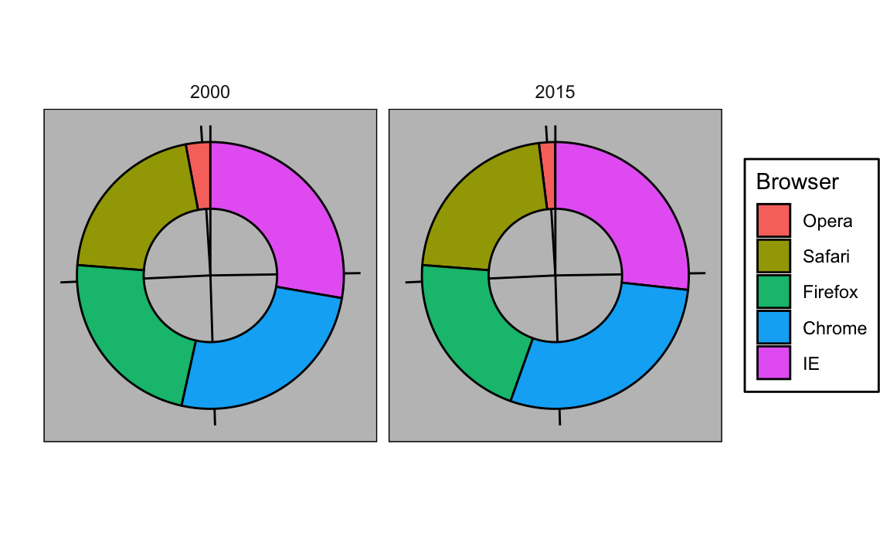
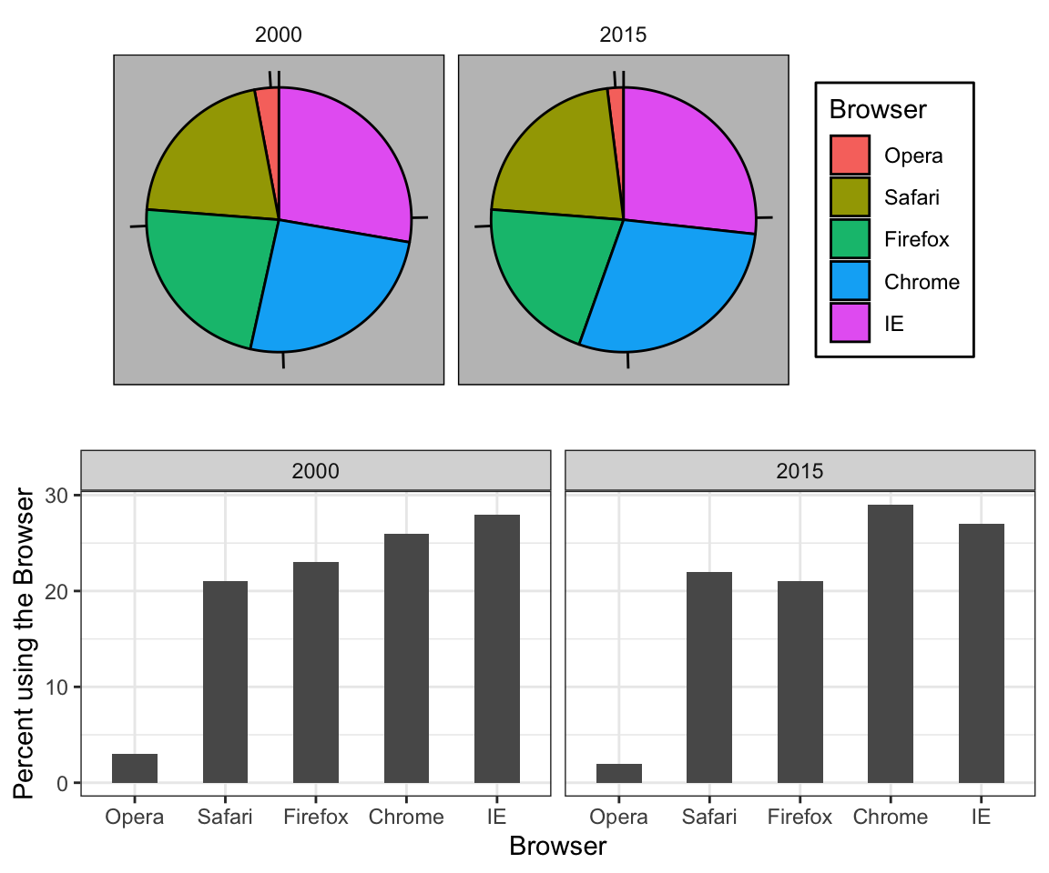
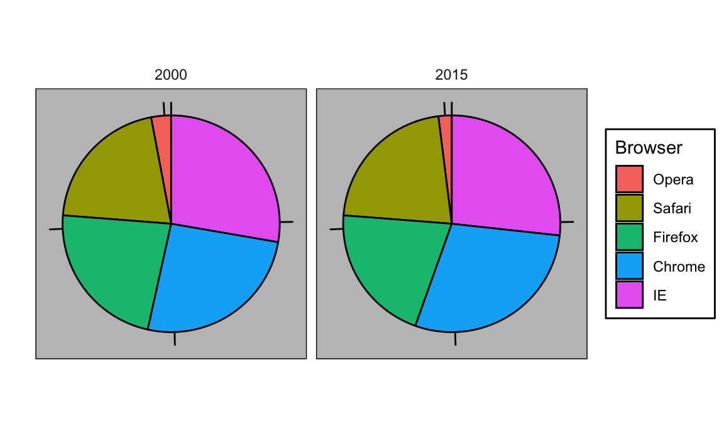
1. Use visual cue
Browser | 2000 | 2015
Opera | 3 | 2
Safari | 21 | 22
Firefox | 23 | 21
Chrome | 26 | 29
IE | 28 | 27

Slide 24
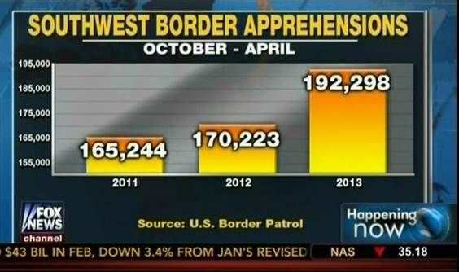
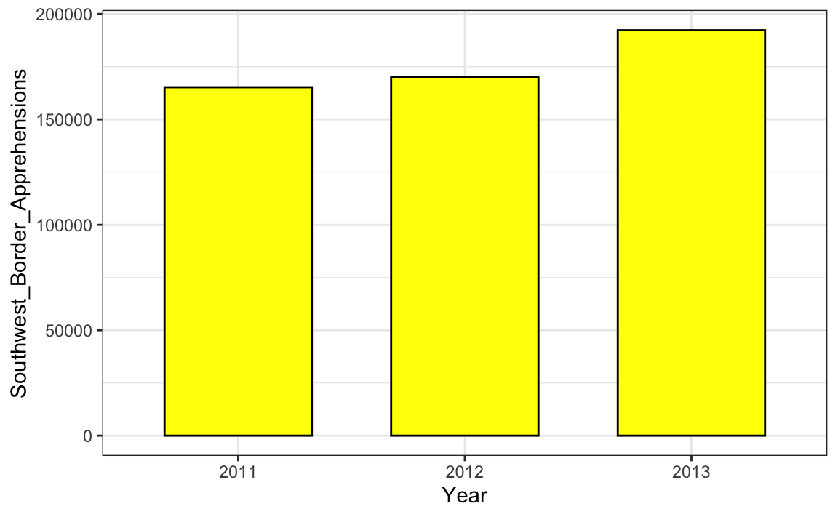
2. Know when to include zero
Important to include when comparison is made based on length
(Source: Fox News, via Media Matters)

Slide 25
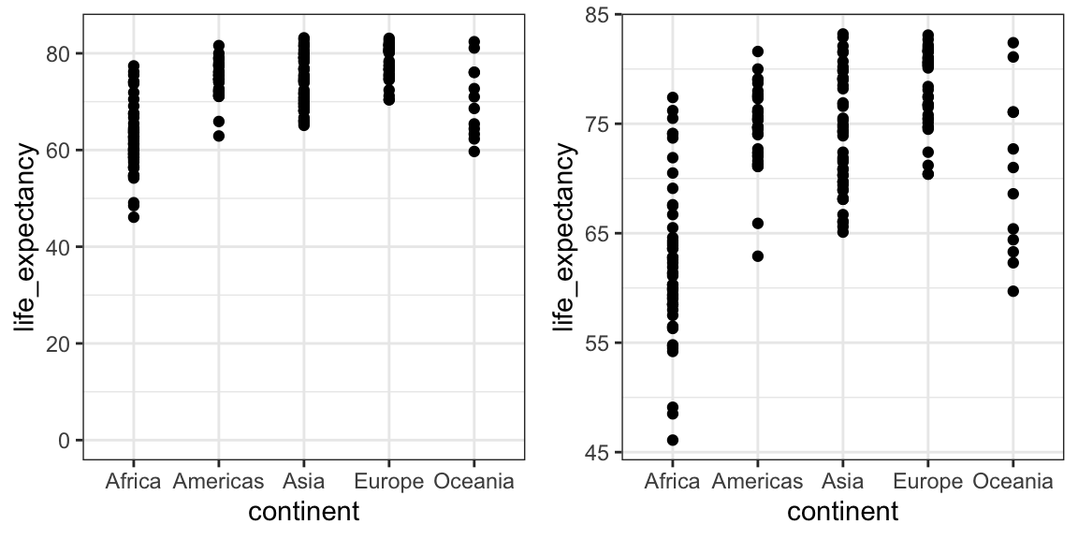
2. Know when to include zero
Not important when position is used for comparison

Slide 26
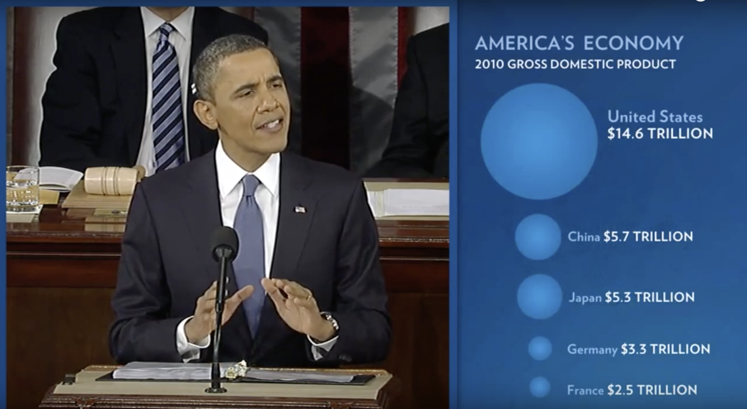
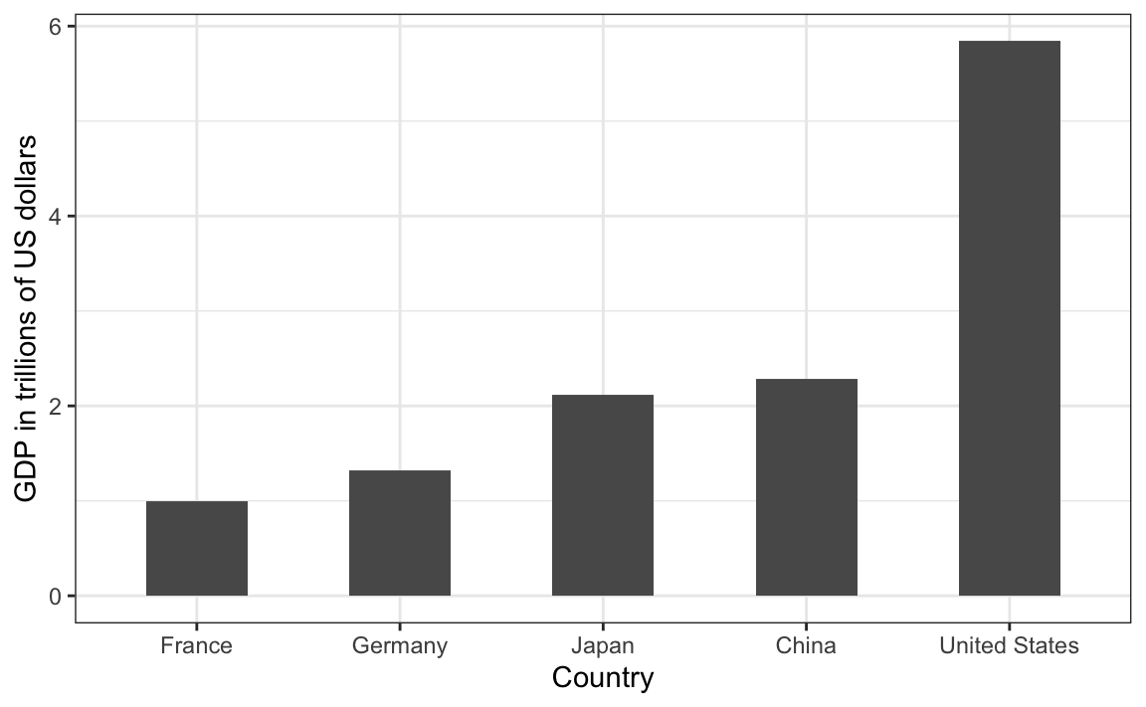
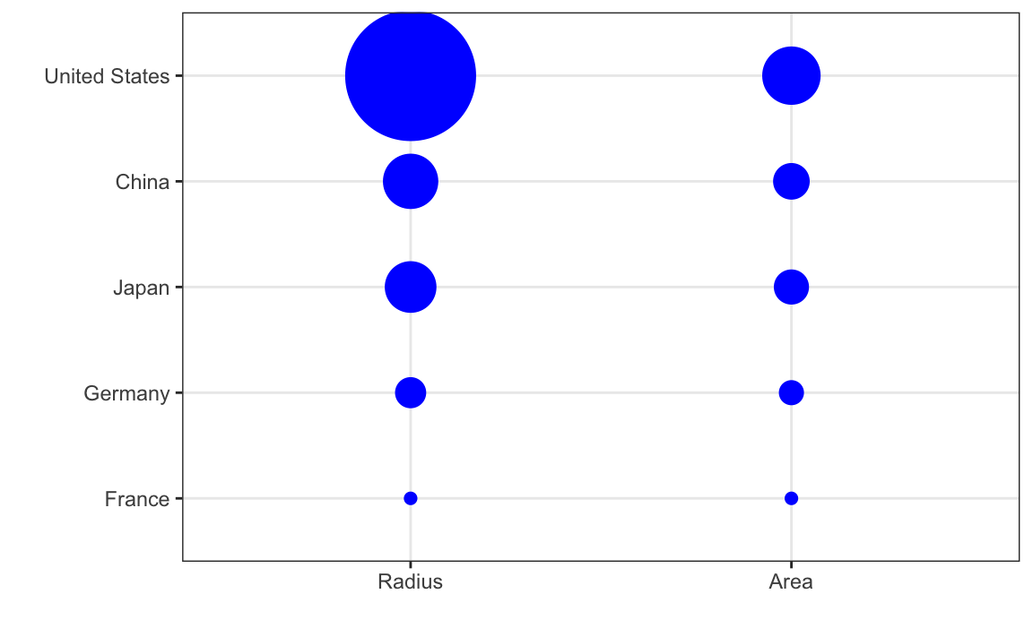
3. Do not distort quantities
(Source: The 2011 State of the Union Address)

